Slide 1


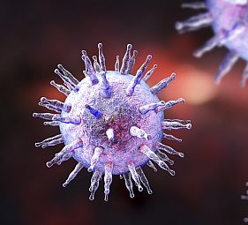
Datathon September 2023
Analysis of COVID on Patients with Multiple Sclerosis (MS)
Team 9 : Analytics Ninjas
Team Lead : Neenu Nair
Team Members : Archana Mukthavaram
Jothi Arumugam
Sreesudha Gadamsetty

Slide 2
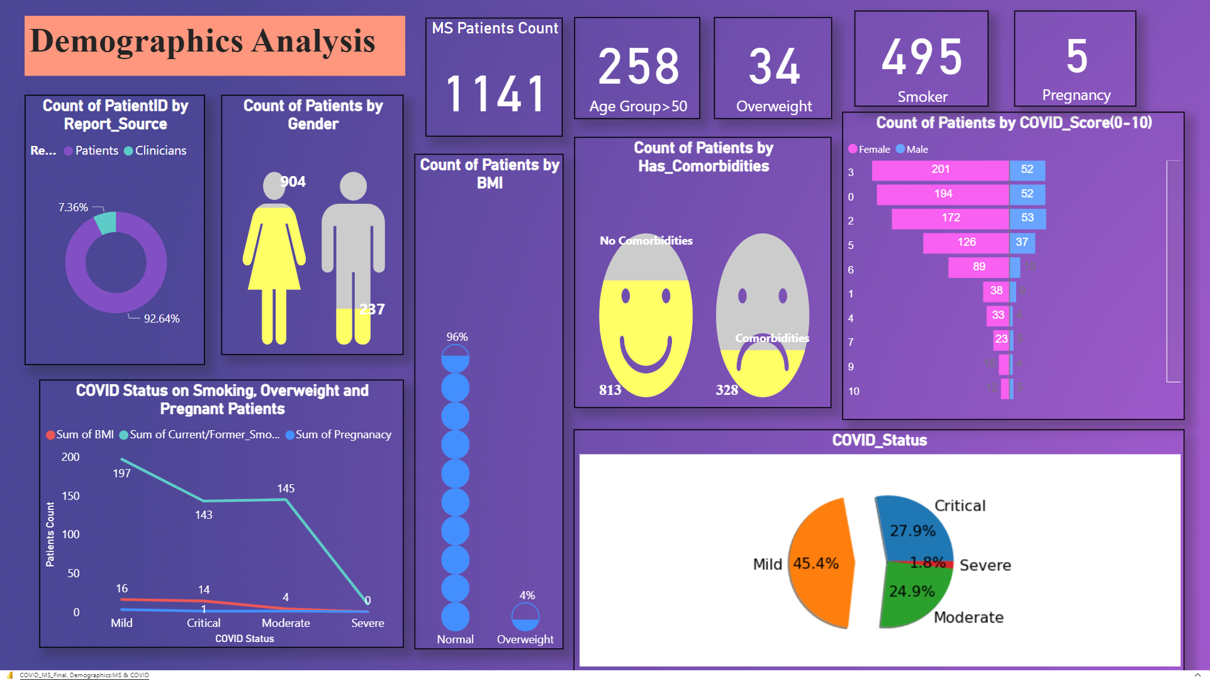

Slide 3
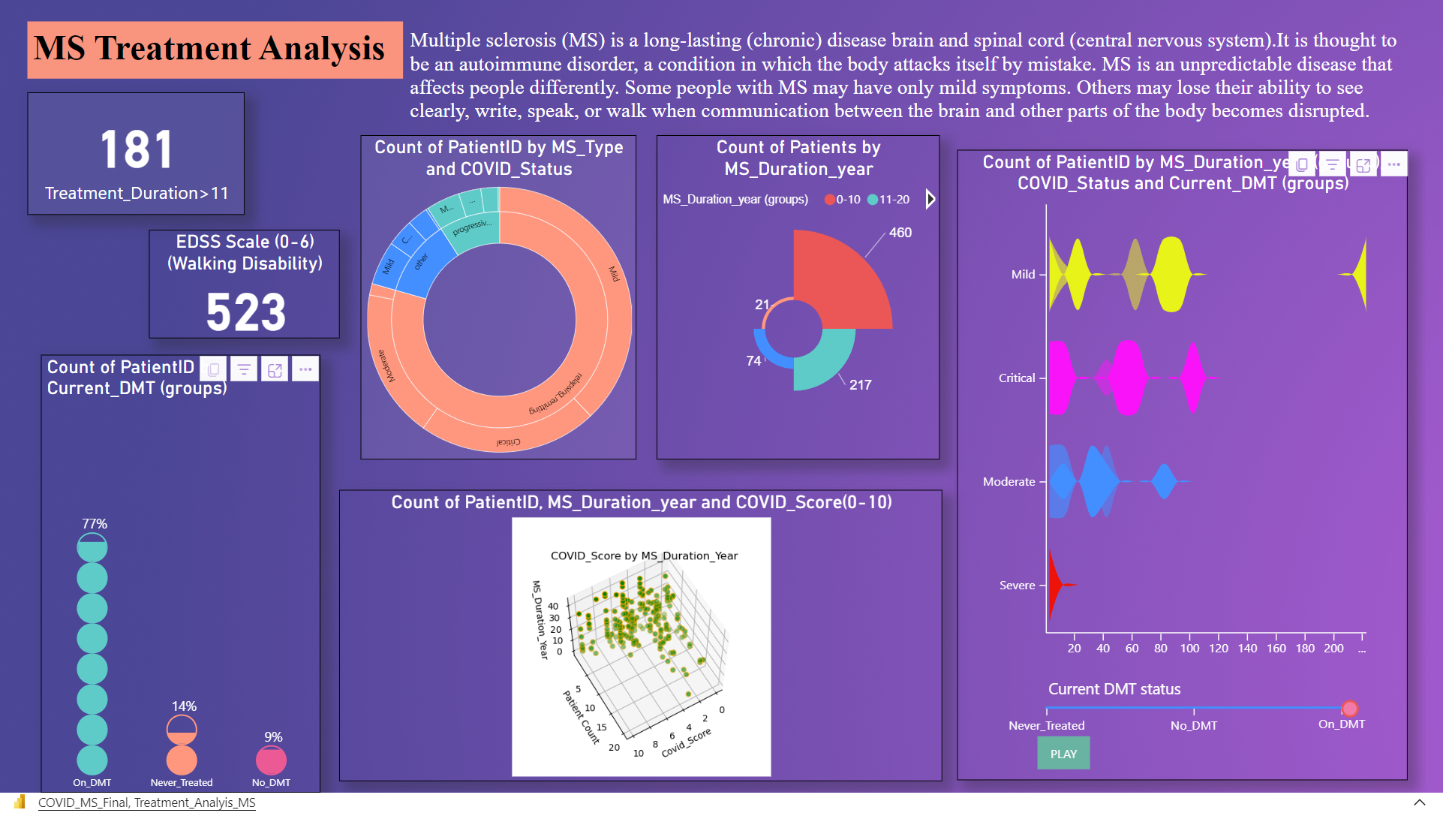

Slide 4
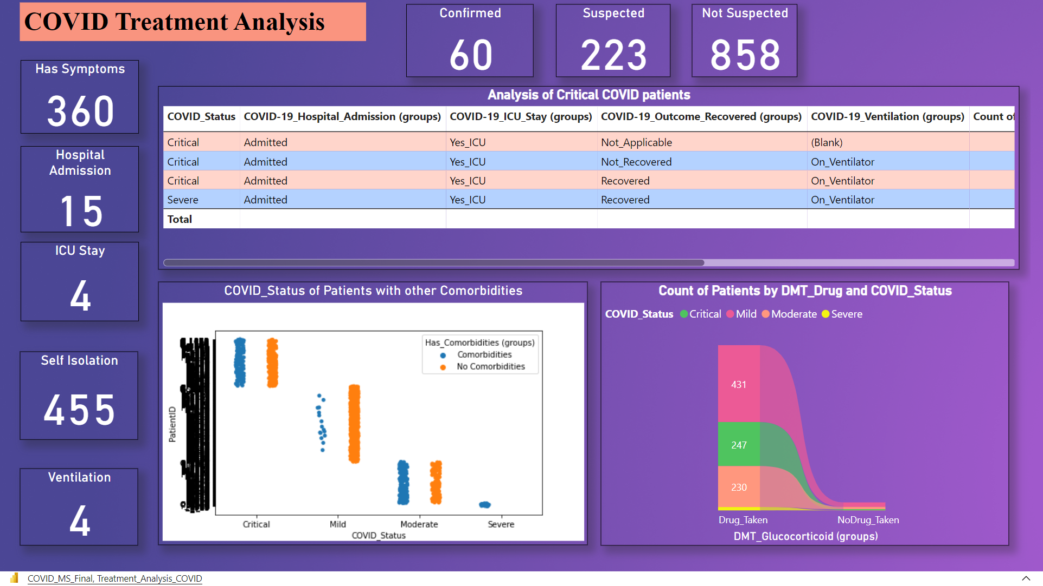

Slide 5
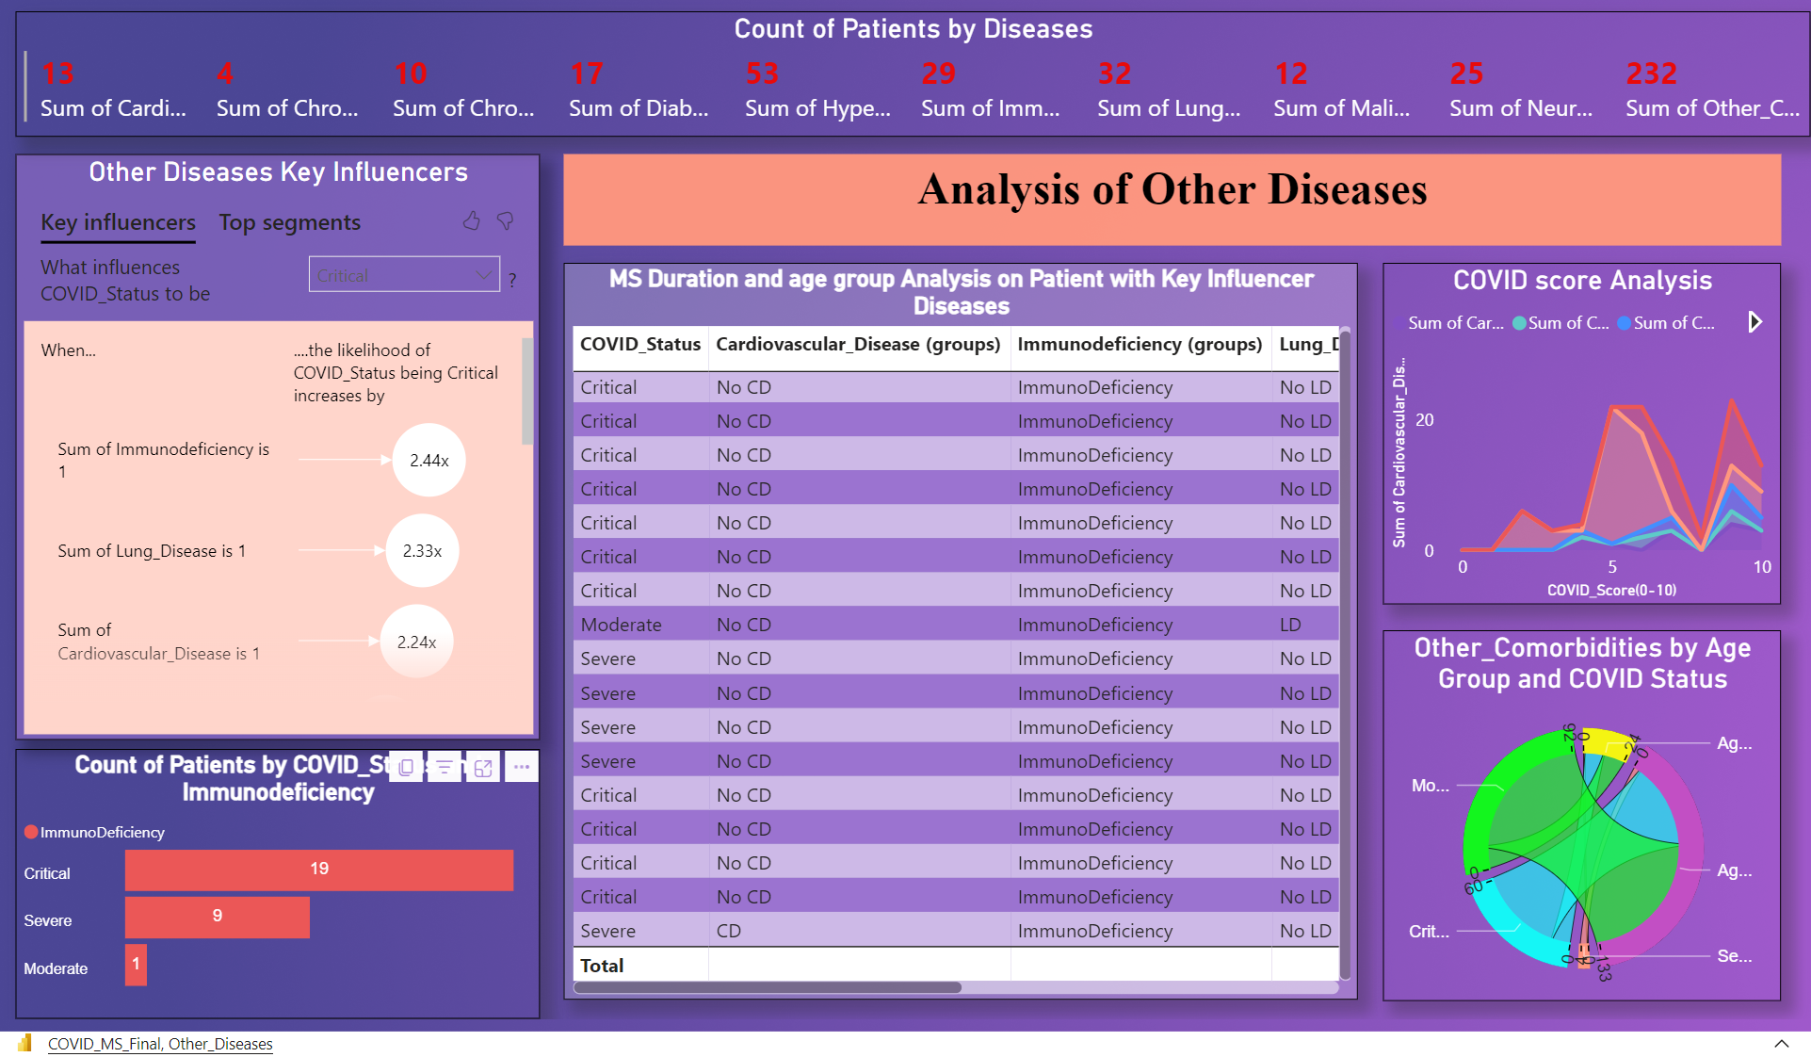

Slide 6
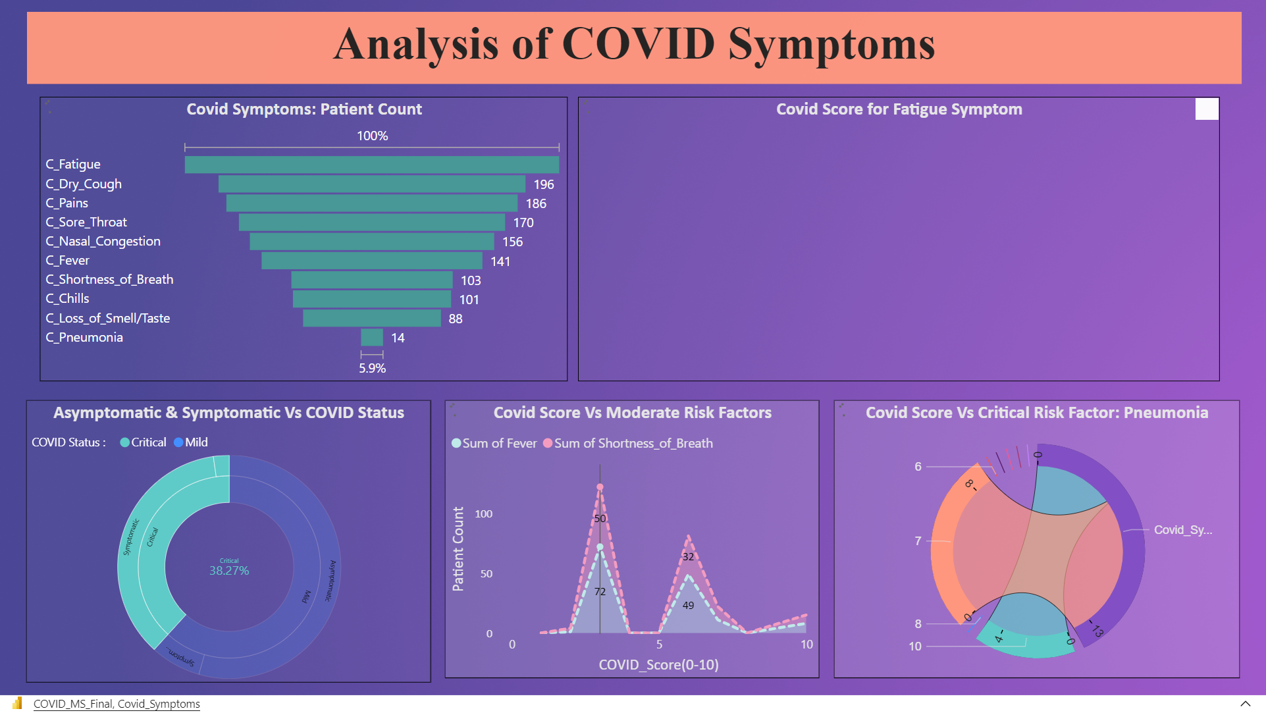

Slide 7
